Slide 1
SECURE DATA HIDING IN IMAGES USING STEGANOGRAPHY
CAPSTONE PROJECT
Presented By:
Student Name : NAGA VENKATA ASHRIT GUTTULA
College Name & Department : SREENIDHI INSTITUTE OF SCIENCE AND TECHNOLOGY
B.TECH (COMPUTER SCIENCE AND ENGINEERING)

Slide 2
OUTLINE
Problem Statement
Technology used
Wow factor
End users
Result
Conclusion
Git-hub Link
Future scope

Slide 3
Problem Statement
This project explores secure data transmission by combining AES encryption with Least Significant Bit (LSB) steganography.
It aims to protect sensitive data sent over untrusted channels by encrypting the data and then hiding it within images, making it undetectable and more secure than traditional encryption methods alone.

Slide 4

Technology used
This project utilizes Python with several key libraries:
OpenCV for image manipulation
Crypto for AES encryption
hashlib for password security
numpy for numerical tasks
base64 for encoding
The user interface is built using Streamlit.

Slide 5
Wow factors
This project enhances security by combining AES encryption with LSB steganography, implemented in a user-friendly Streamlit application.
It features password-based authentication, real-time encoding/decoding, and supports lossless PNG image embedding for secure and undetectable data hiding suitable for sensitive applications.

Slide 6
End users
Individuals : For securely sharing private information (e.g., passwords, documents).
Organizations : For confidential communication and data protection.
Government Agencies : For secure transmission of classified information.
Researchers : For experimenting with advanced steganography techniques.

Slide 7
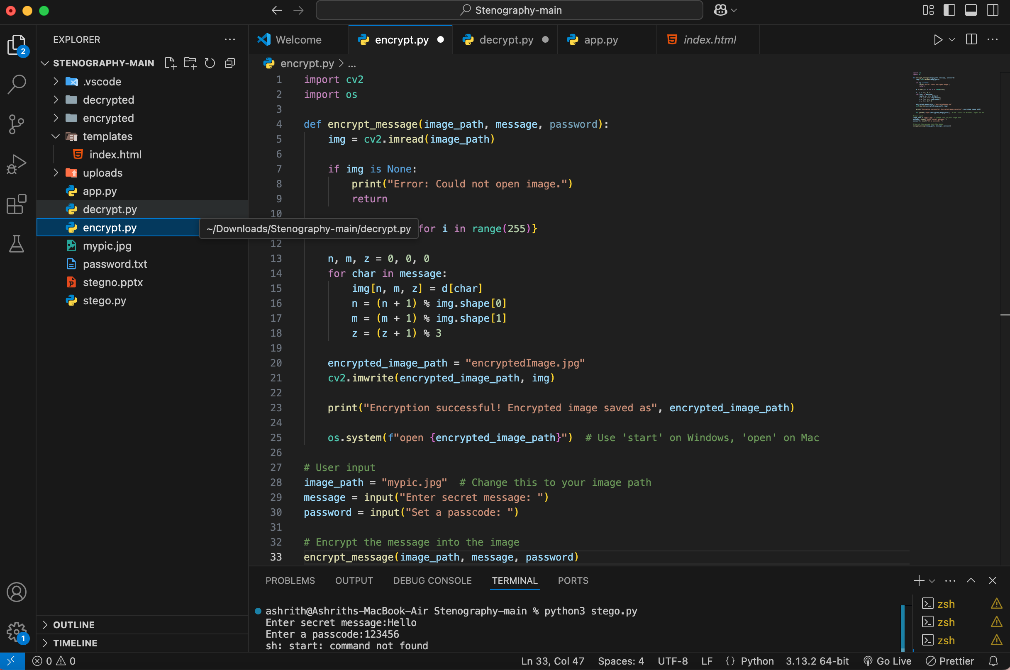
Results
Screenshot 1 :

Slide 8
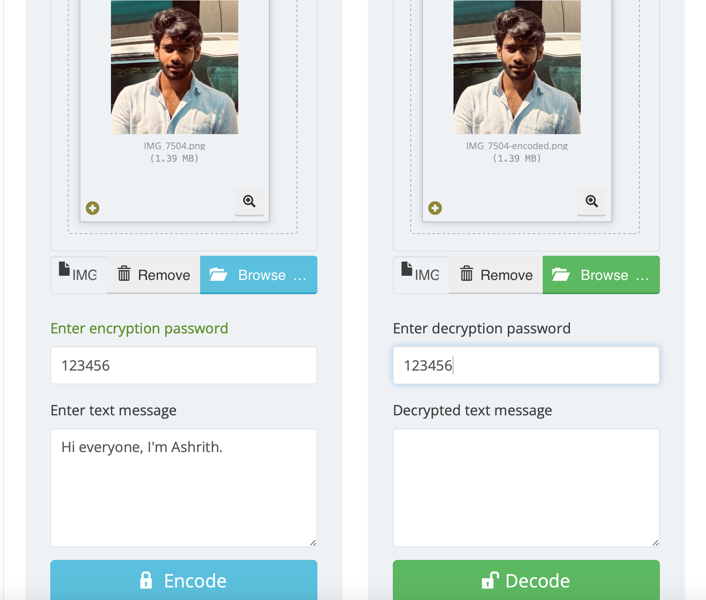
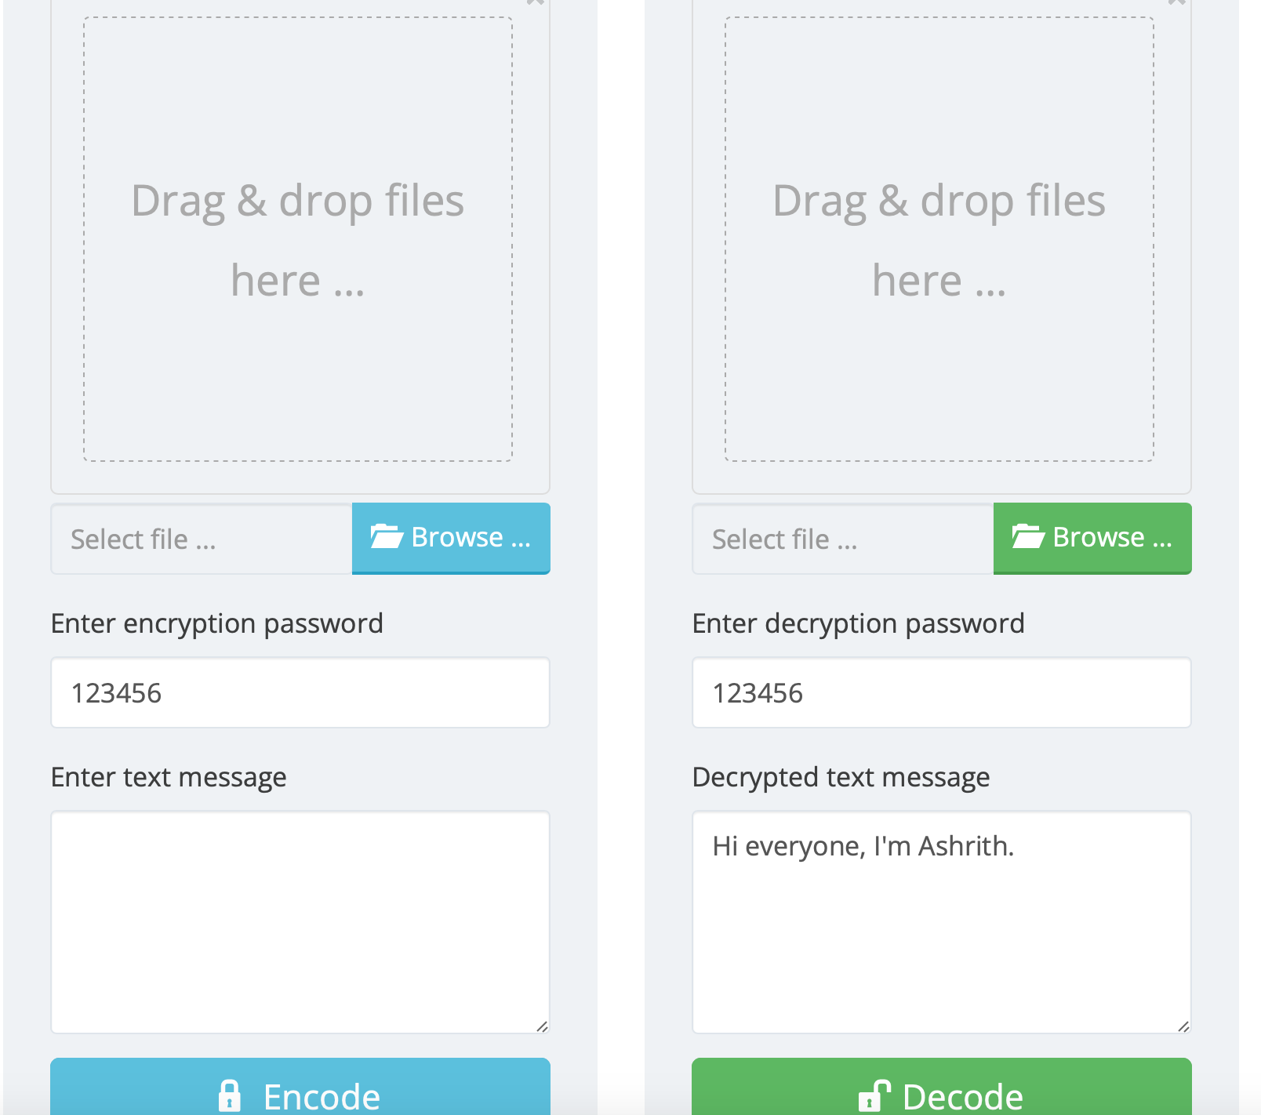
Results
Screenshot 2

Slide 9
Conclusion
This project successfully implements secure data hiding within images by combining AES encryption and LSB steganography, providing a robust and user-friendly solution for secure data transmission.
Additionally, the project leverages a password-based authentication system to ensure only authorized individuals can access the hidden information.
Future development could expand file format support and enhance error handling.

Slide 10
GitHub Link
Repository: https://ashrithg8704.github.io/Secure-Data-Hiding-In-Images-Using-Steganography/

Slide 11
Future scopE
Extend support to other image formats like JPEG and BMP.
Implement multi-layer encryption for added security.
Develop a mobile application for on-the-go secure data hiding.
Explore AI-based steganalysis detection to test the robustness of the system.

Slide 12
THANK YOU

